Slide 1
A New Way for New Talents in Teaching: Accomplishments and Next Steps

Slide 2
EU-Wide Challenges in the Teaching Profession
Teacher shortages and high average age of teachers
Teaching training that is lagging behind the needs of the students in the 21st century
Insufficient practical training of new teachers

Slide 3
NEWTT Consortium
5
National Educational Institutions
Impact Assessment
Austria
Bulgaria
The Basque Country
Romania
Latvia
5
NGOs from the network
2
1
Universities
Industry Organization

Slide 4
Possible Solutions
An innovative master’s degree which attracts new talents to the teaching profession
An effective program which provides motivated candidates with the opportunity to teach and receive intensive and ongoing professional support
Impact assessment and sharing of best practices/lessons learned
Collaboration with government institutions in order to turn alternative pathways to teaching in national and EU-wide policies

Slide 5
MAIN HYPOTHESES
1. The recruitment, selection and initial training methodologies of the NEWTT alternative pathway pilots will generate trainees who are suitable for teaching. Trainees in each national pilot will perform at least on par with initial teacher competence measures of beginning teachers in traditional programs.
2. NEWTT trainees will improve their competence as teachers over the course of the pilots.
3. The overall competence of trainees within the NEWTT alternative pathway pilots will compare positively with those of beginning teachers in traditional programs.
4. At the end of the program the trainees from the NEWTT national pilots will finish their second year at school and will be willing to continue teaching or contributing to the impact of schools for the students they have taught.

Slide 6
The Project in Numbers
Applications
4000 +
Selectivity Rate
>10%
Participants
225+
Training
10+
Schools
145
Support
40-60

Slide 7
Two Highlights
Why did you become a teacher? – motivation by groups
NEWTT trainees
Control group
Job Security
Social Responsibility
Working with children
Subject-Related Motivation

Slide 8
A New Way for New Talents in Teaching
(A University Perspective)
Professor Galin Tsokov, Plovdiv University “Paisii Hilendarski”

Slide 9
Innovative Master’s Degrees - School Pedagogy - a program for middle school and highschool teachers - Primary School Pedagogy

Slide 10
Focus Shift in Teacher Training Towards...
Learning Environment
Content
Teaching Methods
Experience and Practice

Slide 11
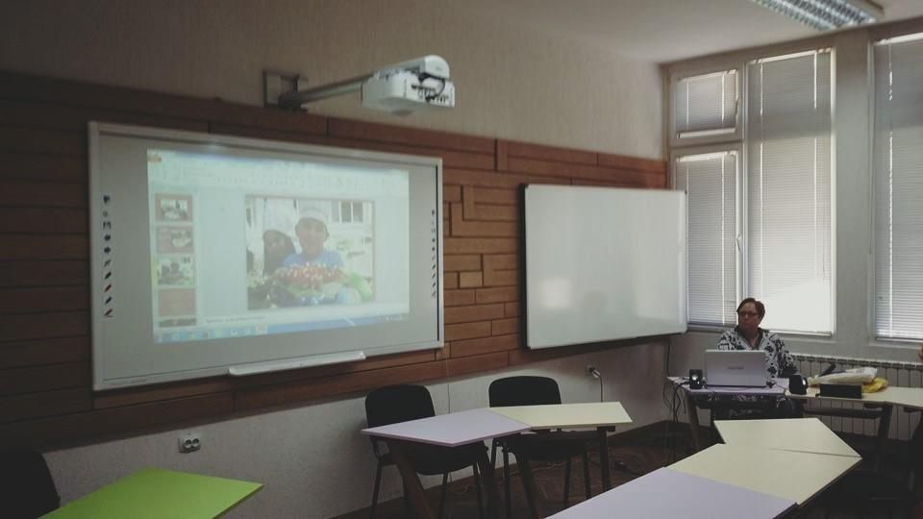
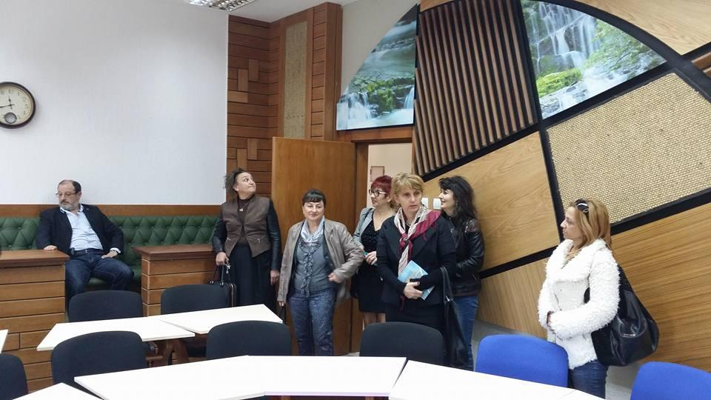
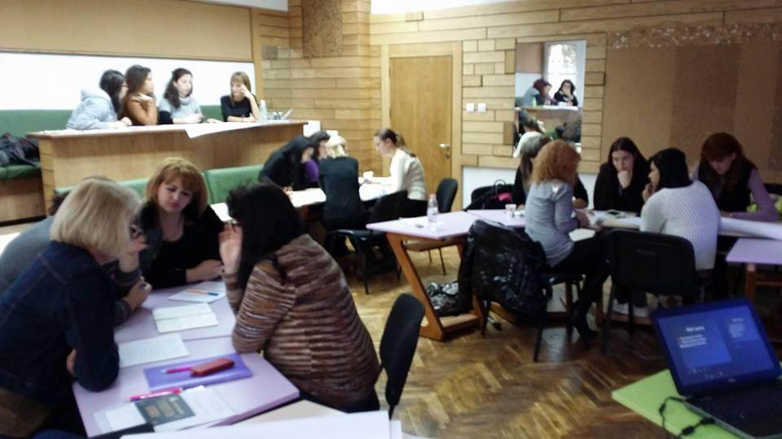
Learning Environment
Interactive training halls – 8
A webinar hall
A “smart” training hall

Slide 12
Content
Focusing on pedagogy, psychology, and leadership when training new teachers (a necessity brought by the modern role of the teacher)
Implementing new courses in the curriculum such as School Leadership, Classroom Management, Project-Based Learning, School Partnerships - Collaboration with Parents, Innovations in Education, Motivation Strategies, Inclusive Education

Slide 13
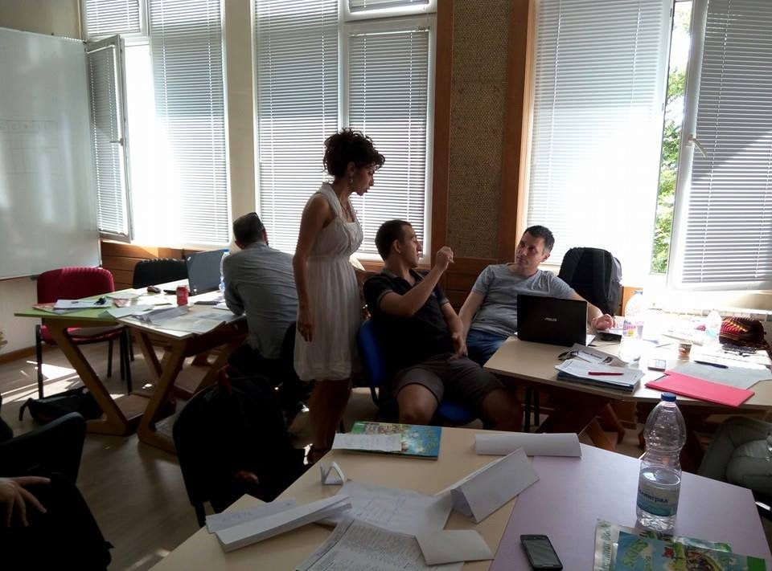
Innovative Teaching Methods
Working with interactive whiteboards
Planning multimedia lessons via mozaBook
Utilizing interactive teaching methods such as group discussions and project-based learning

Slide 14
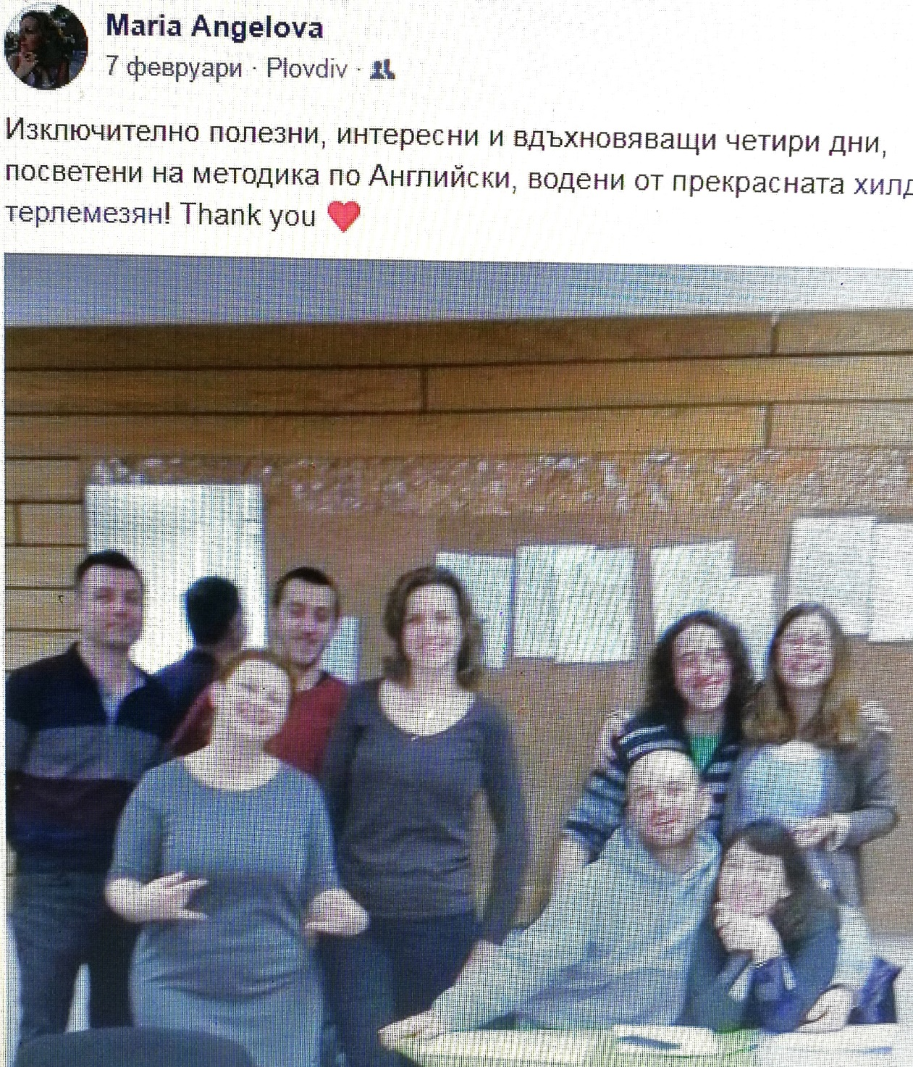
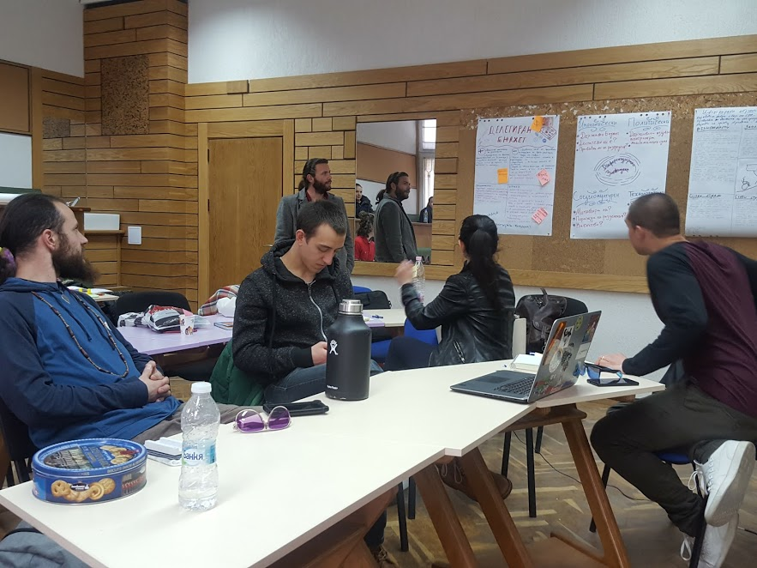
“Exceptionally useful, interesting, and inspiring 4 days dedicated to ESL methodology and led by the wonderful Hilda Terlemezyan! Thank you <3”
Notes:
Exceptionally useful, interesting, and inspiring 4 days dedicated to ESL methodology and led by the wonderful Hilda Terlemezyan! Thank you <3

Slide 15
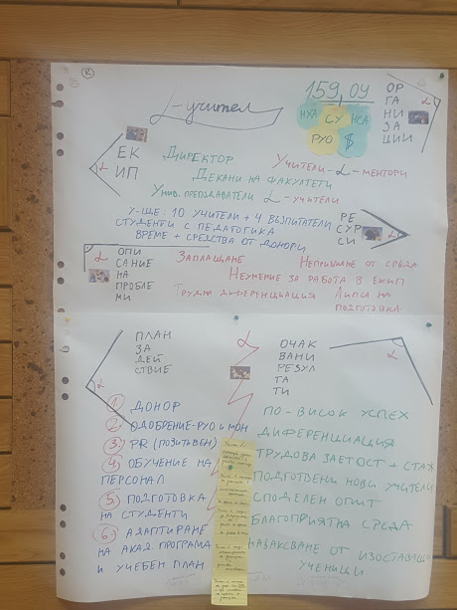

Slide 16
Training Based on Practice and Gaining Experience
Online lesson observations
Practical training after the first theoretical semester which includes working at an actual school allowing teacher-interns to develop their professional competencies, pedagogical and methodical skills
Support and mentorship - at pilot schools by teacher mentors and at the university by academic mentors

Slide 17
Conclusions
A successful and creative collaboration accomplished by building a professional network (Ministry of Education and Science-University-NGO-pilot schools)
Focusing on pedagogy, psychology, and leadership when training new teachers
Expanding the practical training modules and providing professional support to new teachers
Changing the training model for new teachers
Changing the accreditation procedures for university teaching programs
Training and qualification of new teachers - a leap towards better quality education provided by schools in Bulgaria

Slide 18
Thank you!

